Slide 1


Community Engagement techniques
PREPARED BY: THE COMMUNITY ENGAGEMENT IN PLANNING COURSE IN THE CITY & METROPOLITAN PLANNING (CMP) DEPARTMENT AT THE UNIVERSITY OF UTAH
FOR: THE ASSET-BASED COMMUNITY DEVELOPMENT (ABCD) INSTITUTE AT DEPAUL UNIVERSITY

Slide 2
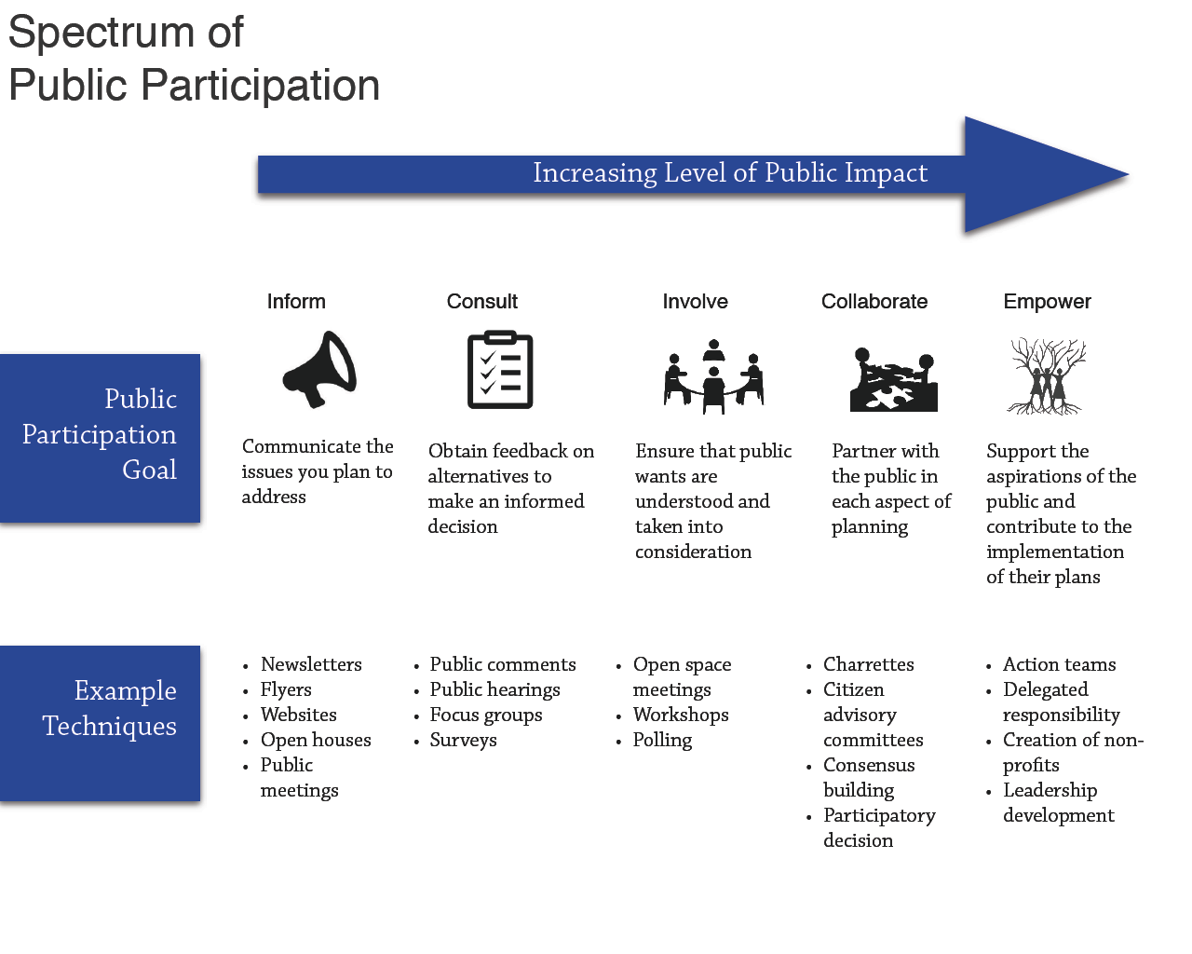

Slide 3
INFORM

Slide 4
Social Media
Overview: Social media is being increasingly used to inform community members of opportunities for engagement
  Approximately 7 in 10 Americans use at least one social media site (Pew Research Group)
  Information can be disseminated almost instantaneously
  Can be used as a way to engage in and of itself, so it can be a consistent resource for citizens throughout the engagement process
Appropriateness:
  Should not be used alone, but rather in conjunction with other techniques
    Especially should not replace face-to-face interaction
  Can be useful for informing community members at any level of participation

Slide 5
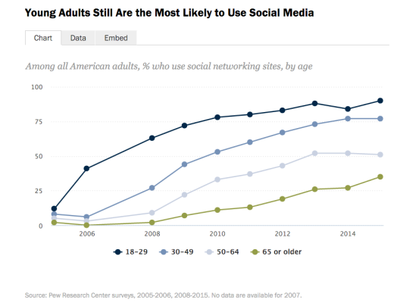
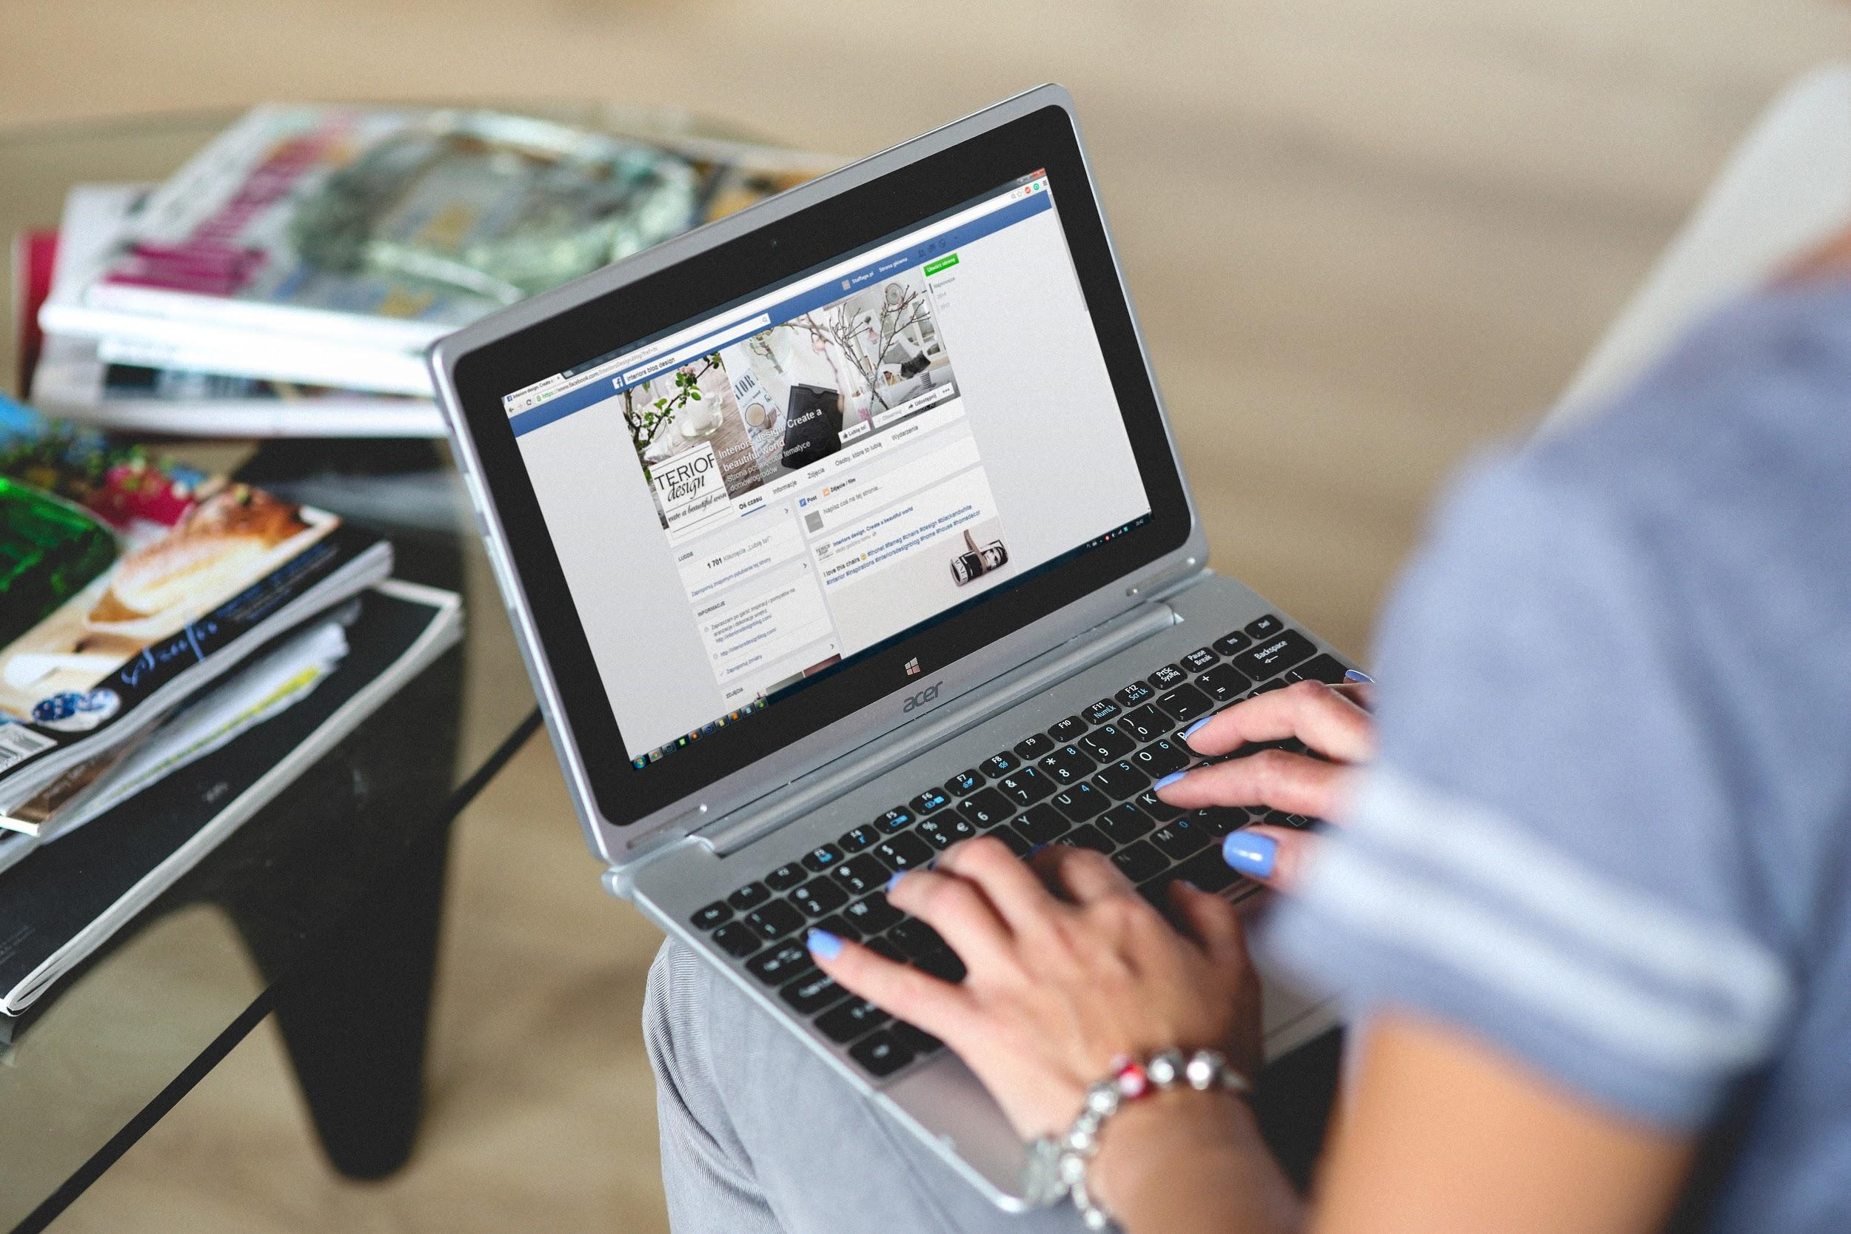
Social Media
Weaknesses:
  Requires internet access
  Often requires users to have social media accounts
  Could require a moderator
  People could misrepresent themselves
Strengths:
  Cost-effective
  Quick distribution of information
  Can reach diverse populations
  Beneficial for visual learners

Slide 6
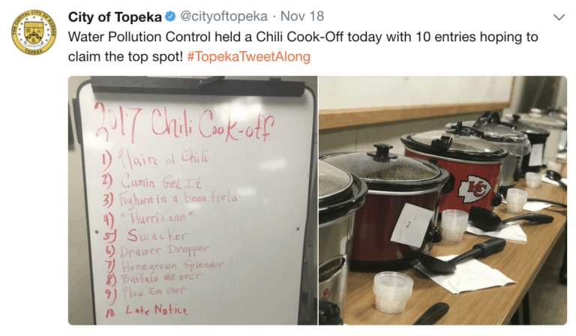
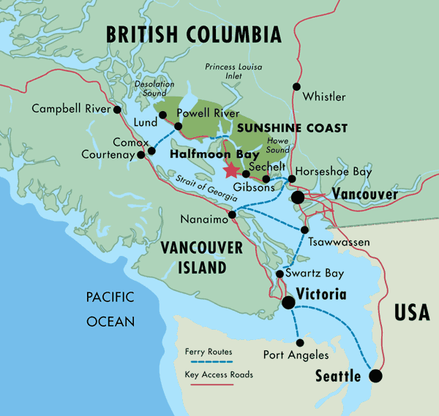
Social Media
Case study #1: Topeka, Kansas
  Following an event in the community that caused contention, the city wanted to “deliver a message on (its) own terms”
  Started the hashtag #Topekatweetalongs to inform community members about various jobs in the government, as well as upcoming events
  Led to increased interaction between community members and city employees
https://www.bangthetable.com/blog/case-study-social-media-to-increase-community-interest-in-government/
Case Study #2: Nanaimo, British Columbia
  Began online engagement efforts in 2009 by using Facebook, Twitter, and YouTube
  Regularly posted videos of city council meetings, including time-stamping important issues on city website
  Used social media sites to point people to website and inform them of community events
  Saw a “tenfold increase in council meeting viewings”
https://www.usdn.org/uploads/cms/documents/community-social-engagement-guidebook-and-case-studies.pdf

Slide 7
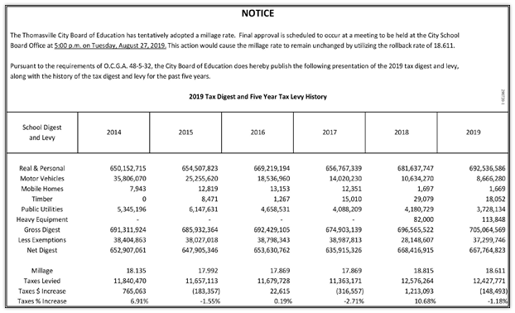
Traditional Media
What is it?
  Television
  Print
  Radio
Used to inform community
  Meeting notices
  Meeting outcomes
Complement to Social Media
Often a person’s first contact with an issue

Slide 8
Traditional Media
Strengths
Capable of reaching broad audience
Can generate local interest at the beginning of the community engagement process
Low cost
Easily replicable
Weaknesses
Impersonal
Difficult to gauge effectiveness
No actual engagement
Excludes people who don’t watch tv, listen to the radio, or read the newspaper

Slide 9
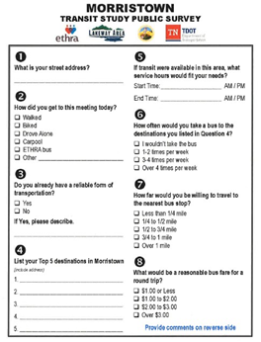
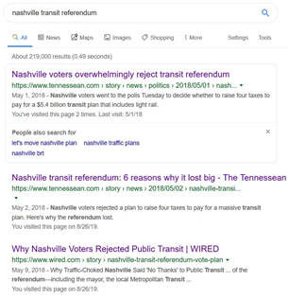
Traditional Media
2018 Nashville Transit Referendum
No media until plan had already been developed
Failure
2018 Lakeway Transit Plan
Media requesting public input
Success
AECOM 2018
Google 2019

Slide 10
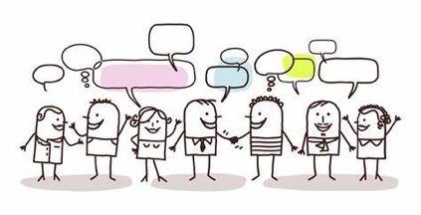
Public Meeting
Overview
A traditional method to bring people together to collaborate on a specific issue.
Provides the opportunity to bring various stakeholders together for a particular goal.
Provide the chance of information sharing, questioning, and discussing an issue or a proposal.
Public meetings can be used at any size and do not need to follow any agenda or script.
Some people may not feel confident to speak in front of the public.
Appropriateness
Consider a series of meetings rather than a single meeting.
Meetings have to be publicized and advertised.
This public sharing will show openness and transparency.

Slide 11
Public Meeting
Weakness
Only a small population of the community may have the time and concerns to attend the meetings
Some attendants may have not confidence enough to speak and express their thoughts in front of a large group
People participate in the meetings only when they have deep concerns about the issue. Therefore, participants of the meetings may not come from a broad range of interests in which they can be account as the representative of the community
Conflicts may happen and be deepened during the meetings and limit the contributions
Strengths
Provide a large number of people with the opportunity to share their thoughts, ideas, and concerns
Provide an opportunity to discuss the processes, to share information, and to get feedbacks
Provide the opportunity to build consensus for support and action on complex issues
Provide the opportunity to develop networks and to demonstrate transparency

Slide 12
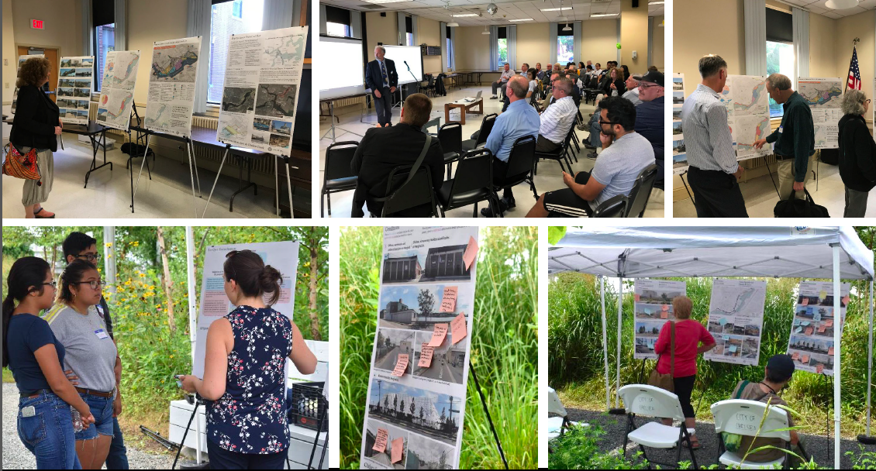


Public Meeting
Case study #1
Walk, Bike, Hike Plan- Somerset County, NJ
https://www.co.somerset.nj.us/government/public-works/planning/walk-bike-hike-plan
Case Study #2
Chelsea Municipal Harbor Plan and Designated Port Area (DPA) Master Plan, Chelsea, MA
https://www.chelseama.gov/sites/chelseama/files/uploads/chelsea_creek_municipal_harbor_plan_and_dpa_master_plan.pdf

Slide 13
CONSULT

Slide 14

Consult: Citizen Panel
Overview: They can help to stimulate public viewpoints about issue-related & concentrated areas
⇨ gather together to choose to defend or provide criticism
⇨ add democracy’s value to representative opinion
⇨ become potable meeting for triggering democratic opinion sharing process
Appropriateness
⇨ grant more functional public participation to more targeted community members
⇨ more participants of citizen panel can develop themselves in conditional practices while they are situated in various context of environments in community planning process

Slide 15
Citizen Panel
Weakness
⇨ Same panel members would be lack of diversity
⇨Full attendance is not mandatory for everyone
⇨Repeated expression will demoralize members
⇨Cannot monitor fluctuation in each person’s opinion on timely manner
Strengths
⇨More flexible participation
⇨ High time-efficiency in conveying opinions
⇨ Shared Information would be more accurate
⇨ Notify member groups of any updated message

Slide 16
Citizen Panel
Case study #1: Canada Renewable Energy Project
→ citizen panel’s role in participating in the project really emphasize the importance of citizen pane in decision-making process
→ many citizen panel members do not realize their own limitations on technical knowledge horizon scope
→ , some of members definitely objected to initiated renewable energy operation facilities installed on the local area due to somewhat possible noises and ecological disturbance while some other people didn’t see that as main concern.
Case Study #2: Swedish New Energy Construction Project
→ The initial draft plan of new energy initiative had been delivered out to community members for feedbacks
→ Most of members from citizen panel are made up of individuals recruited from advertisement broadcasted to each family household among the local residential area
→The local official directly looked for some citizen panel members and thus that eventually guaranteed the diversity of entire citizen panel

Slide 17
Community Survey
Overview: Helping planners to gather information from targeted members
Defining the sample size and the type of information
Deciding the type of survey to be used
Survey Design
Piloting the survey
Gathering the survey result and analysis
Appropriateness:
Cannot provide meaningful community engagement
Should be a supplementary of other methods

Slide 18
Community Survey
Weakness
The rate of response relies on the types of distribution.
Providing little meaningful community engagement.
The questions of survey should be clear and short enough.
Language could be a barrier.
It cannot provide a real sense of community engagement.
Strengths
Providing evidence if planners try to make decisions.
Easy to gather quantitative data.
It reflects the demands and information of most people.
Distributing very fast and easy to access by using the Internet.
Saving data for comparing in the future.

Slide 19

Community Survey
Case study #1
Community Engagement in Austin, MN
https://www.betterenergy.org/blog/community-engagement-austin-minnesota/
Case Study #2
“I Value” Program in Hampton, VA
https://knightfoundation.org/media/uploads/publication_pdfs/BrightSpots-final.pdf
https://www.facebook.com/cityofaustinmn/
https://hampton.gov/DocumentCenter/View/20839/FY19-I-Value?bidId=

Slide 20
Consult: Art and Creativity
Overview: engage diverse communities and populations from all social strata
Utilizing creativity and arts as a mode of communication
Arts as a promotion of cultural and community diversity and inclusivity
‘Creative Placemaking’
Social capital, new ideas, and community identity
Appropriateness:
Highly applicable to engaging both culturally and socioeconomically diverse communities
Should be used as a primary engagement method

Slide 21
Art and Creativity
Weakness
May be subjectively disempowering to individuals experiencing a lack of cultural, creative, or artistic identity
Indeterminate population growth and tourism effects on city resources
May not reach certain age groups
May be perceived as exclusively group or non-group modes of engagement, and thus potentially non-inclusive in that capacity
Strengths
Encourages community members and individuals to express values, ideas, and future expectations in those less verbally vocally-empowered
Can be seen as a way to reach youth and other populations, such as cultural minorities
Empowers cultural minorities to express opinions in non-traditional, yet equally inclusive ways
Promotes healthy community ties and dynamic interrelationships
Can reflect city and community identity
Economic advantages

Slide 22
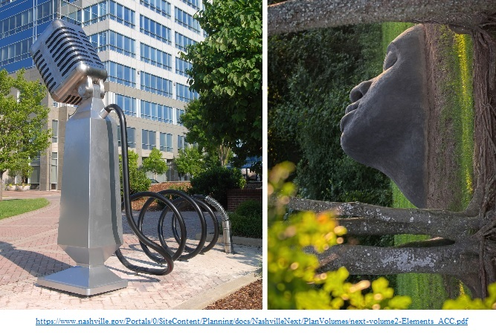
Art and Creativity
Case study #1:
San Francisco Market Street Prototyping
http://artsandplanning.mapc.org/case-study-san-francisco-market-street-prototyping/
Case Study #2:
Creative Placemaking in Portland, Maine
http://artsandplanning.mapc.org/case-study-creative-placemaking-in-portland-maine/1

Slide 23
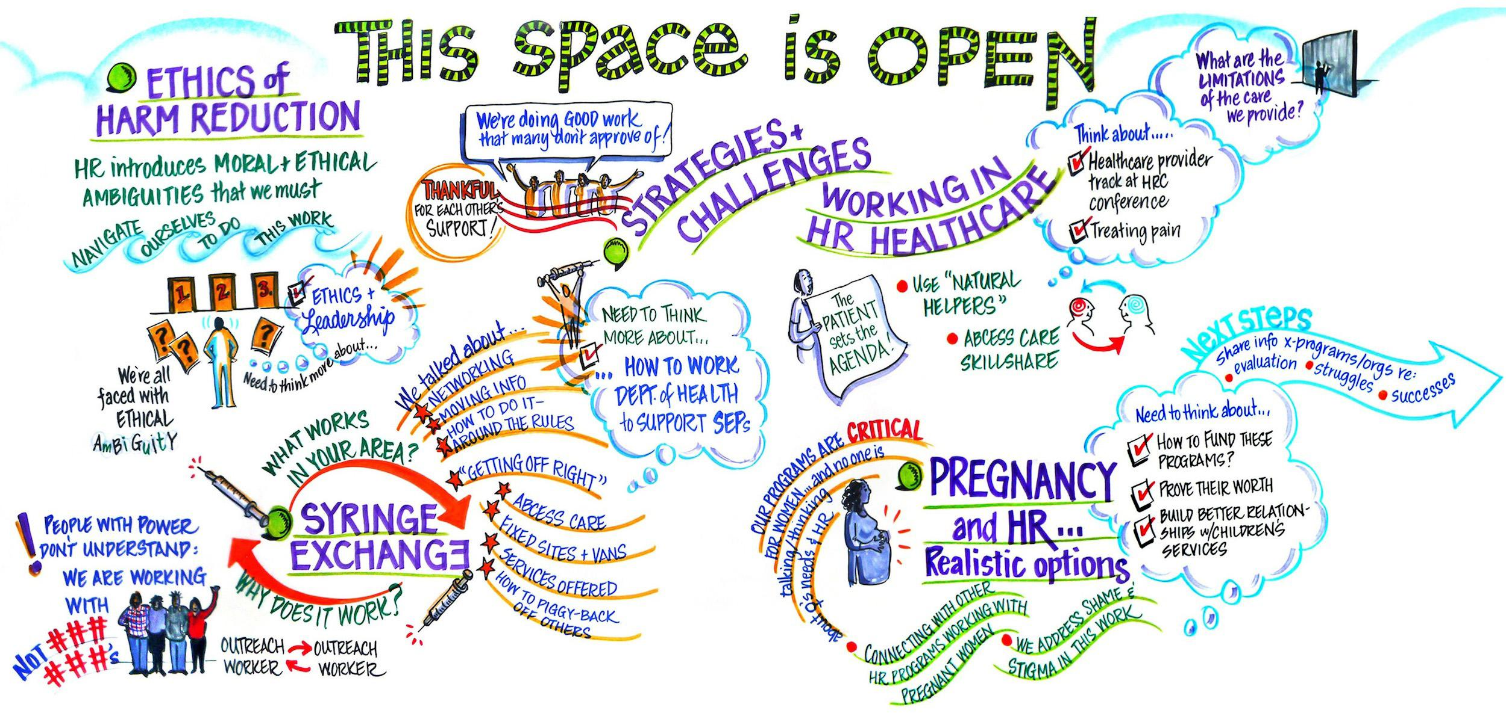
Consult: Open Space
Overview: This can be a great place for communities to gather in an natural undeveloped environment within their community.
⇨ offering an easy local engagement within close proximity within a neighborhood
⇨ allowing everyone to get together and foster social interactions without boundaries
⇨ enhance neighborhood livability and connectivity
Appropriateness:
⇨ Corresponding to the people that are more likely to attend an outdoor space events

Slide 24
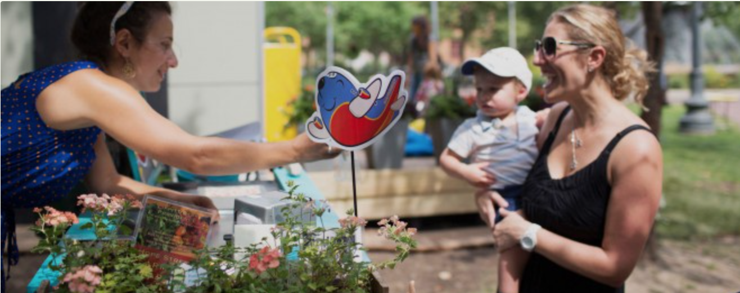
Open Space
Weakness
May not provide enough parking for people who live on the boundary of the neighborhood
Outsourcing public facilities
May not offer easy access for people with disabilities
Strengths
Positive effect on nearby residential property value
Provides healthy environment
Lower impact on CO2 emissions
Family orientated interactions
Lower costs to organize
Making the community feel closer to home

Slide 25


Open Space
Case Study #1
Open Space in Dallas Fort-Worth, TX
https://www.americantrails.org/files/pdf/Economic-Benefits-Active.pdf
Case Study #2
Campus Maritus Park, Detroit, MI
https://pps-placemaking.exposure.co/campus-martius-park-detroit

Slide 26

Focus Group
Overview
•6-12 people discuss an issue in depth
•Purpose: to encourage frank discussions to elicit people’s perceptions, feelings and opinions about the issue.
Appropriateness
•Form of community consultation.
•Designed to specifically concentrate on a single issue or a program of topics.
•Encourages discussion among those who may feel less confident in a larger group, certain interest groups can be targeted.

Slide 27
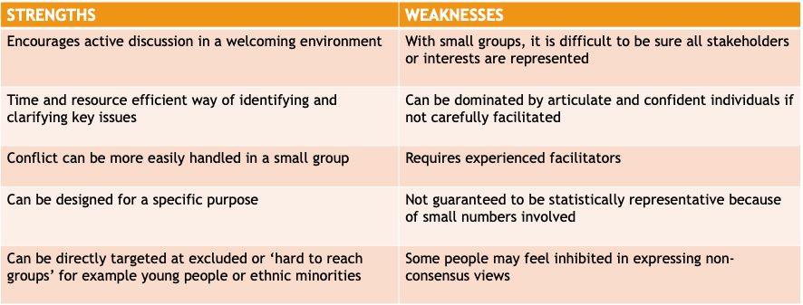
Focus Group – Weaknesses and Strengths

Slide 28
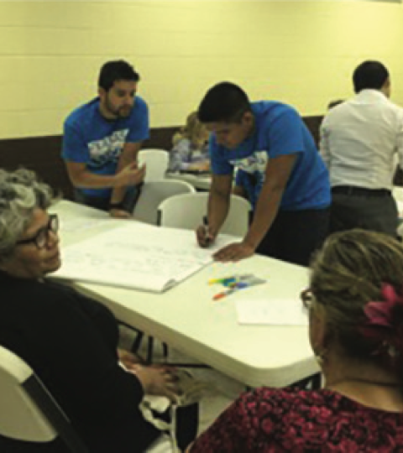
Focus Group – Case Studies
•Scottish Youth Crime Review – Focus groups with young offenders to get their views on why young people offend, how offending might be prevented, experiences of the criminal justice system and the impact of offending on others.
•Brownsville 2015 Platicas– To help planners understand economic development issues surrounding local latino vendor markets. Platicas engaged local market vendors, market management, city officials, and community leaders.

Slide 29
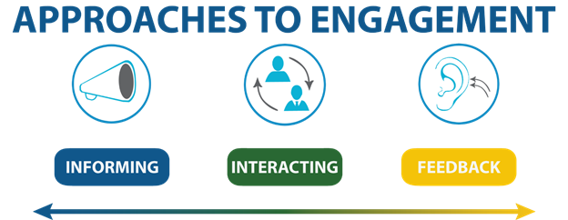
Consult: Street Stalls
Overview: An informal method of engaging large crowds of people in a public setting. A small booth or tent at a community fair is commonplace.
Typically set up outdoors in a busy public setting (fairs, downtown areas, shopping center)
Allows many people to freely interact
Can be informative but also allows for conversation and feedback
Appropriateness:
Gathering data from a large number of people
Engaging people who may be unlikely to attend more formal events
https://minneapolis2040.com/planning-process/

Slide 30
Street Stalls
Weakness
Requires multiple people to be on staff
Too much input could be gathered if crowds are large
Time required to set up the street stalls and any information or interactive exhibits
May need approval to set up in certain areas / during events
Strengths
Allows users to freely speak their mind
Reach an array of audience, some of which may not be inclined to participate in a traditional sense
A large number of people can be engaged
Can generate new ideas
Can gauge public response to a potential project

Slide 31
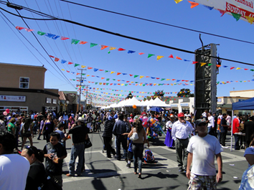
Street Stalls
Case study #1:
North Fair Oaks Community Festival
Case Study #2:
Minneapolis 2040
Set up a booth at a local festival to engage with the Hispanic population
Created interactive way to share thoughts
Many community members thanked the staff for including them
Used community events to engage a variety of people
Seeking input on update to the comprehensive plan
  Goal was to be more inclusive and generate more community feedback
http://colabradio.mit.edu/community-festivals-as-sites-for-community-engagement/

Slide 32
COLLABORATE

Slide 33

Advisory Committee
Overview: advisory committees are made up of individuals who bring past experiences and knowledge related to the goal or problem that is trying to be achieved or fixed within the community; usually may be elected to position or chosen specifically for committee.
      These committees can make recommendations and give important info or materials to everyone they are serving for
      Advisory committees play an important role in public relations as they can serve as liaisons between groups and be advocates for groups or people
      The goal of advisory committees is to help direct the goals and purpose of various groups working together
Appropriateness:
An advisory committee is a good idea any time large
groups in the community are going to be affected by
something
When there may be a gap in communication between
the community and a governing group for example

Slide 34
Advisory Committee
Weakness
Can become the middleman between the community and other group(s) which may lead to little engagement between all parties
Advisory committee members may want some sort of incentive
Need to meet regularly be productive
Because the committees are generally smaller, they cannot always represent and voice everyone, only a majority
Strengths
Consist of members who are knowledgeable on the subjects at hand
Are often elected or put into position by those who they are representing and guiding and are easier to trust
Tend to keep the various parties focused on the goal or purpose of the community needs
Can be more diverse of who makes up the panel
Helps promote public relations
Many have limited term lengths as to provide a rotation of those who are part of the advisory committee

Slide 35
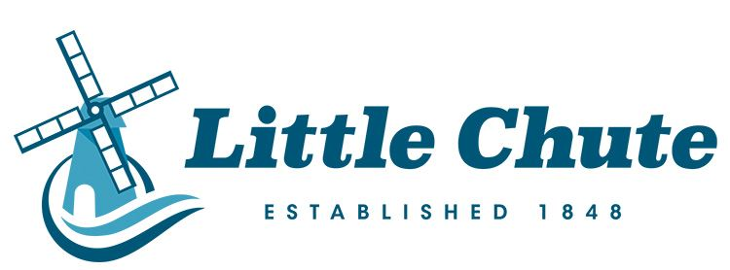

Advisory Committee
Case study #1: Graham Advisory Commission
From their website: “...meetings are held within the community and facilitate a structured two-way communication process between the County and community residents, property owners, and business owners regarding significant land use issues.”
https://www.piercecountywa.org/5935/Graham-Advisory-Commission
This committee is just one of many Pierce County (Washington) has listed on their web page. This one pertains to planning, but they also have ones for accessible communities, developmental disabilities, and many other subjects.
Case Study #2: The Strategic Planning Advisory Committee - Little Chute
From their website: “...an ad hoc committee. While there were a lot of meetings and discussions on the future of Little Chute, now that the plan is adopted, the real work begins.”
https://www.littlechutewi.org/376/Strategic-Planning-Advisory-Committee
This committee is a good example because they only meet when necessary. As they said themselves, they reached their goal, and now they can move forward. It seems that until there is need for new development in Little Chute (Wisconsin), they do not need to meet.

Slide 36
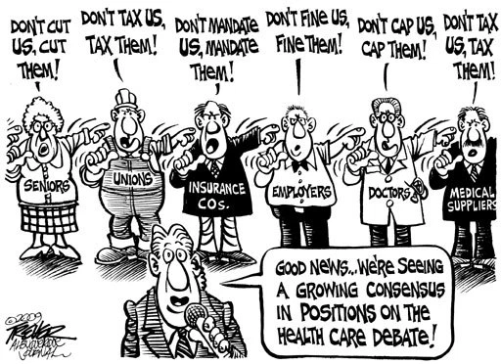
Consensus Building
Overview: Consensus building enlists the input from an identified list of representatives from relevant stakeholder groups to solve complex problems spanning multiple issues.
Organized and conducted by a facilitator or mediator
Ultimate goal of establishing consensus rather than a majority vote
Appropriateness: Consensus building is well suited as a policymaking tool within a city’s governmental civic engagement program.
Local government can help ensure that funding is available
Institutionalize as a city decision making tool/engagement strategy for complex planning issues

Slide 37
Consensus Building
Weaknesses
Time intensive
Potential for Groupthink, or the desire to reach consensus without appropriate examination of good/bad ideas
Requires trust between parties
Participants are typically granted only advisory, not decision-making, powers
Strengths
Increased quality of solutions
All parties’ interests are voiced and protected through participation process and outcomes
Decisions are representative of the larger community
Increases cooperation between adverse groups to strengthen relationships and overcome disparities
Creates a process for working on future problems

Slide 38
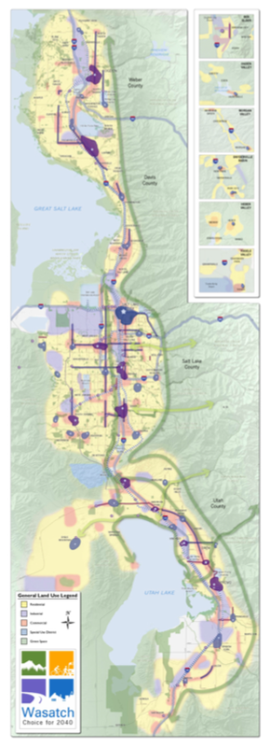
Consensus Building
Case study #1: Chattanooga, TN + Vision 2000
Need for long-term planning emerged in the mid-1990’s as a result of population boom
Municipal planners opened the door to public participation, using a variety of tools including consensus building
Workshops, public meetings, and surveys resulted in the engagement of 1,700 citizens
Robust outcomes resulted from consensus between community partners, trained and civilian planners, and policymakers
Case Study #2: Wasatch Choice 2040
Envision Utah partnered with local, regional, and state agencies to create long-range transportation planning
Intensive research and analysis of existing conditions and community values prior to engagement process
Identified leaders across all impacted municipalities along the Wasatch Front and facilitated discussions
Consensus as an outcome tool led to creative solutions and goals for regional transportation planning

Slide 39
EMPOWER

Slide 40

Citizen Committees
Overview: Citizen committees enable a selected group of community representatives to actively participate and help directly make decisions on issues that affect the community
  Usually appointed by members of the government, but established committees may also appoint members on their own
  Generally small but representative of a diverse range of perspectives
  Can be a useful way to manage community empowerment
Appropriateness
  Long term public input needs (regular meetings in perpetuity)
  Short term public input needs (meetings continue for a set period of time, usually until the stated goal is accomplished)

Slide 41
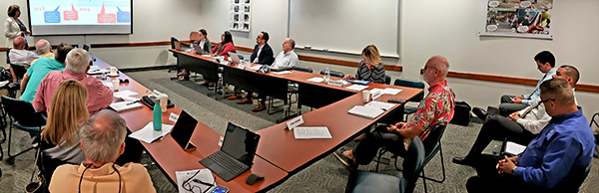
Citizen Committees
Weaknesses
Relatively small groups
Elevates certain community voices above others
Can be a significant time commitment
“Citizen Committee” term itself may not be fully inclusive of immigrant community members
Strengths
Allows for non-government perspectives to be hears
Can be restricted to people with certain qualifications
Useful for both short and long term
Creates a liaison between residents and government

Slide 42
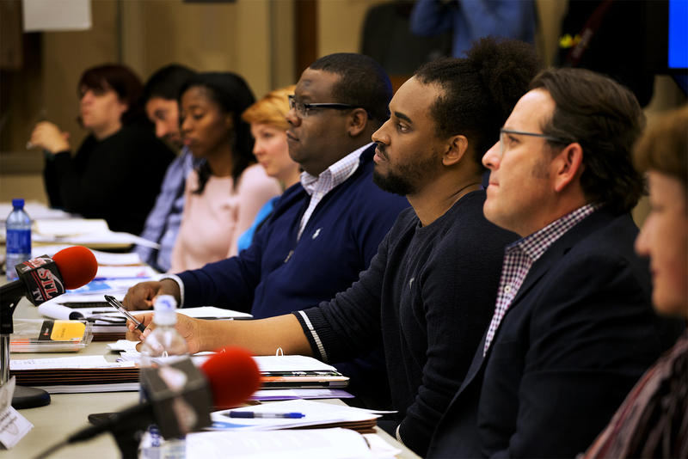
Citizen Committees
Case study #1: Citizens’ Advisory Board, Chicago Metropolitan Agency for Planning
What: citizen committee to help develop and implement long range transportation plans in metro Chicago
When: ongoing, quarterly meetings
Why: transportation affects everyone, so diverse community input is essential
Results: Committee has made provided essential input to CMAP on issues from road improvements to reinvestment in disinvested areas.
Case Study #2: Citizen Advisory Board, City of St. Louis
What: 13 member citizen committee to select new police commissioner, appointed by mayor
When: June - December 2017
Why: address distrust of police department; promote community safety and security; improve community-police relations
Results: Committee was able to shape the selection process from the start. Committee eventually submitted six finalists to the mayor. All finalists had support of community representatives.

Slide 43
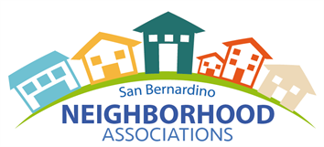
Neighborhood Associations
Overview: Neighborhood Associations are a group of residents who meet together to achieve specific goals within their community.
Brings various members of the community together to accomplish similar goals
Anyone can be apart of a neighborhood association
Residents know what is best for their community
Appropriateness:
Aids in planning being tailored to the neighborhood
Ensures “bottom to top” planning

Slide 44


Neighborhood Associations
Weakness
Can be turned into self-promoting/political agenda/soapbox
People can still have a fear of speaking out or engaging with other people
Time consuming
It may not be accurate representation of the community as a whole, but just representation of a certain group of people (vocal minority)
Strengths
Helps residents build relationships
Effective resources for the citizens in the community
The organization can help residents succinctly share opinions with elected officials
Citizens take ownership in projects within their community

Slide 45
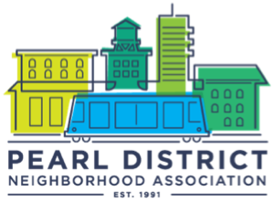
Neighborhood Associations
Case study #1: Logan Square Neighborhood Association
Strong communities = strong schools
Make schools centers of community life through Community Learning Centers,
Develop school/community partnerships with parents as leaders, and
Develop the ParentTeacher Mentor Program to help parents develop their skills, assist teachers, and build strong relationships in the community.
http://www.newcommunities.org/cmadocs/LSNAindicatorsstudy.pdf
Case Study #2: Minneapolis’ Neighborhood Revitalization Program
“We received a wake-up call from a homeowner survey that showed that 20 percent of then current homeowners planned to move out of the city within five years.” -Bob Miller, Director of Minneapolis’ Neighborhood Revitalization Program
City officials focus on revitalizing downtown had lead them to neglect their neighborhoods
https://spatial.usc.edu/wp-content/uploads/2017/03/Holzer_Richard.pdf

Slide 46
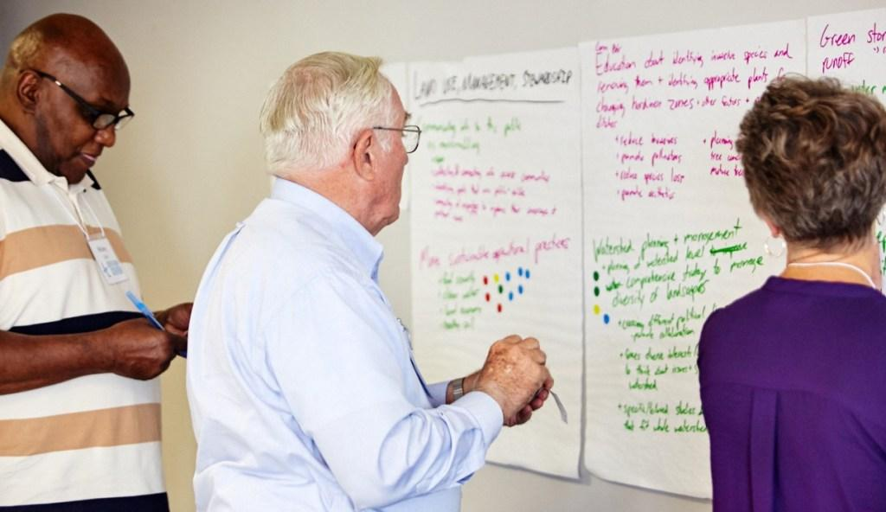
Citizen’s Panels: Overview
•Citizen’s panels are a way to engage community members through an ongoing panel.
•A citizen’s panel typically consist of 10 to 2,000 or more people which represent a community at-large and its multifaceted character.
•Each panelist is surveyed one or more times per year to measure changes over time or a lack thereof.
•Citizen’s panels provide an opportunity for community members to voice their community’s assets, shortcomings and represent a range of opinions.
Although used for a variety of reasons, citizen’s panels are a productive tool in Comprehensive Planning processes.

Slide 47
Citizen’s Panels: Strength & Weakness
WEAKNESSES:
•Same panelists may decrease new or creative insights
•Turnover in panelists reduces validity of measured changes
•If unbalanced, one stakeholder’s voice may get stifled
•Inadequate periodical surveying design may not allow for proper dialogue or response
•Process is fairly unregulated and hard to ensure its validity
STRENGTHS:
•Panels reflect a variety of voices in a community
•Volunteer panelists increase public responsiveness
•Provides a way for community members to voice opinions out of a public spotlight
•YOY changes can be measured through long-term panelists through surveys
•Turnover may lead to an ongoing or refreshed group of panelists

Slide 48
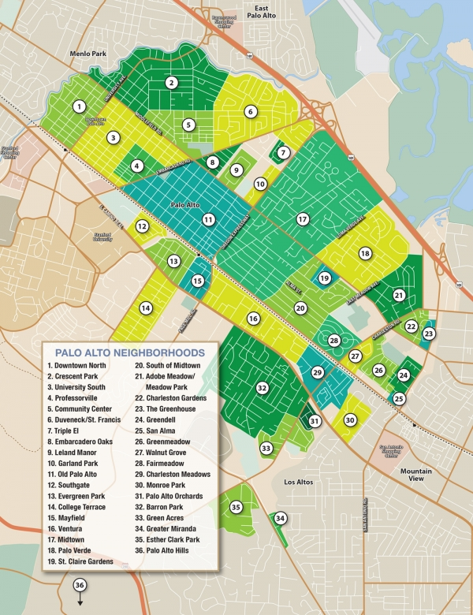
Citizen’s Panels: Case Studies
Massachusetts Office for Health and Human Services (2013):
•Designed a targeted approach for developing autism data collection.
•Sought public input for improving care, identifying funding sources and recipients, and coordinating information to patients
•Panel was comprised of: people on the autism spectrum, parents of individuals with autism, and researchers
•Developed a final report and policy recommendations for Executive Office of Health and Human Services, the governor’s Autism Commission and other state policy makers
Palo Alto, CA Comprehensive Plan Update (2006-2016):
•Local Government appointed 17 panelists to represent Palo Alto
•regional advocates argued the citizen’s panel was geographically unbalanced and had conflicting interests
•No way to ensure that panels will represent all “sides of the isle” or neighborhoods involved in plans
•Out of the 36 neighborhoods in Palo Alto, only 5-7 were represented in the citizen’s panel

