Slide 1
Teaching in Today’s Political Climate
Sidebars for “Improving Information Literacy Can Help Us All”

Slide 2
Political Climate
Our “Bubbles”
Information Literacy
Acknowledgement
Reflection
Empathy
Evaluation
LSP 121
Become Informed Consumers of Statistics
The assignment
Skepticism
Cognitive Bias
“Funky” – an example
Correlation is Not Causation

Slide 3
Bubbles
Everybody's in a Bubble, and That's a Problem
In politics as well as business, people are shaped by who they see—and who they don't.
The Atlantic
Derek Thompson Jan 25, 2017
https://www.theatlantic.com/business/archive/2017/01/america-bubbles/514385/
In Virginia, a state of political separation: Most Clinton voters don’t know any Trump voters, and vice versa By Laura Vozzella and
Emily Guskin Washington Post - Virginia Politics September 14, 2016
https://www.washingtonpost.com/local/virginia-politics/in-virginia-a-state-of-political-separation-most-clinton-voters-dont-know-any-trump-voters-and-vice-versa/2016/09/14/f617a2b8-75e8-11e6-b786-19d0cb1ed06c_story.html?noredirect=on&utm_term=.9a2b05eb0d01

Slide 4
Information Literacy
identify
find,
evaluate,
apply, and
acknowledge
https://prezi.com/s7xnb-bgrujk/5-components-of-information-literacy/

Slide 5
Information Literacy
http://youtu.be/1ronp6Iue9w

Slide 6
LSP 121
Quantitative Reasoning and Technological Literacy II
Liberal Studies Program
First-Year Program

Slide 7
LSP 121
S9 - Statistics That Deceive

Slide 8
Do you believe everything you hear or read ?

Slide 9
The "experts" wouldn't lie…
would they ?

Slide 11
Be an informed consumer of statistics
Be skeptical
Ask questions
Who says so ?
How do they know ?
What’s missing ?
Did somebody change the subject ?
Does it make sense ?
Whose agenda is being served ?

Slide 12
Cognitive Biases
a systematic pattern of deviation from norm or rationality in judgment.
Haselton, M. G.; Nettle, D. & Andrews, P. W. (2005) In D. M. Buss (Ed.), The Handbook of Evolutionary Psychology: Hoboken, NJ, US: John Wiley & Sons Inc. pp. 724–746.
https://en.wikipedia.org/wiki/Cognitive_bias
https://en.wikipedia.org/wiki/List_of_cognitive_biases

Slide 13
Creating statistical evidence to support a point of view
An example – Funky
…this was really easy to create from existing sources

Slide 14
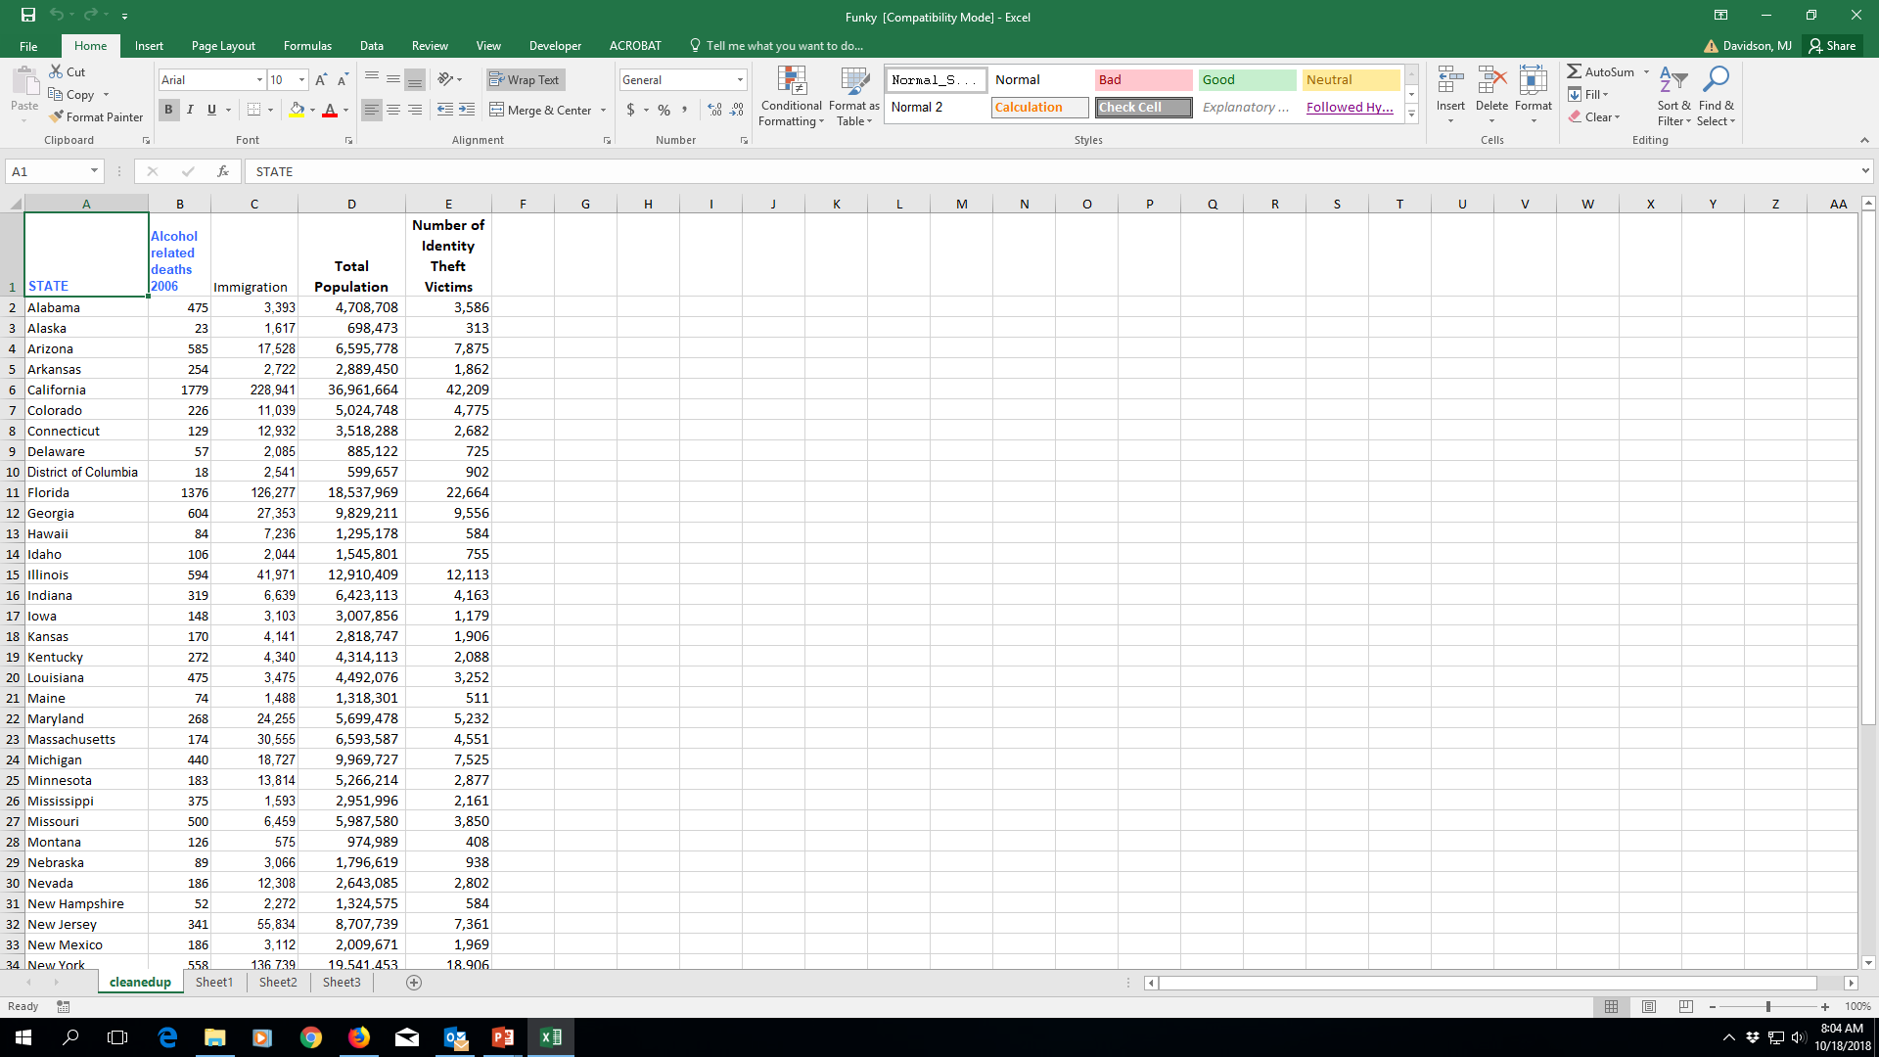
Funky – Excel file

Slide 15
Pearson R Correlation via SPSS
Correlations
 |  | Immigration | Number of Identity Theft Victims
Immigration | Pearson Correlation | 1 | .935**
 | Sig. (2-tailed) |  | .000
 | N | 51 | 51
Number of Identity Theft Victims | Pearson Correlation | .935** | 1
 | Sig. (2-tailed) | .000
 | N | 51 | 51

Slide 16
LSP 121 Assignment Question in 2016
3. Statistics In Everyday Use
Find three articles in the popular media (e.g. newspaper, web-site) that include statistics (presented as numbers or as graphics or in both ways.)
These should be three separate articles/sources, not three examples of statistics in one article
A. For each article/statistic:
1. Summarize the article and the statistic(s) it contains briefly, or copy the article, including the statistic(s) you are critiquing, into your Word document.
2. Include a citation of the source of the article.
B. For each article/statistic:
1. Do you think that the statistic or the way it is used/presented is deceptive?
2. Why or why not?
3. What is your evidence?

Slide 17
LSP 121 Assignment Question in 2018
4. Statistics In Everyday Use
Choose three articles/postings that you have recently read in the popular media (e.g. newspaper, web-site, blog) that include statistics (presented as numbers or as graphics or in both ways.)
These should be three separate articles/postings, not three examples of statistics in one article/posting
A. For each article/posting:
1. Summarize the article/posting and the statistic(s) it contains briefly, or copy the article/posting, including the statistic(s) you are critiquing, into your Word document.
2. Include a citation of the source of the article/posting.
B. For each article/posting:
1. Do you think that the statistic(s) it contains or the way they are used/presented is deceptive?
2. Why or why not?
3. What is your evidence?

Slide 18
mdavidson@cdm.depaul.edu
Thank you!

