Slide 1
From DePaul University Mission
DePaul continues its commitment to the education of first generation college students.
The faculty, learned yet learning, gives substance to the mission of the university.
Through their dedication to learning,.., and their faith in the potential of their students, the faculty and staff serve as role models for students.

Slide 2
The Vincentian Question
What must be done?
What Must I Do?
What Must You Do?
What Must We Do?

Slide 3
Relate
Be approachable
Be accessible
Be a good listener

Slide 4
First Generation Faculty Stories
Dorothy Kozlowski (Interim Dean, CSH)
https://www.youtube.com/watch?v=SOxbtXQRGFc&index=1&list=PLtoq9AtlUbZz4qzUvT3agsrd__Z7JfxxI
Ruben Parra (Chemistry)
https://www.youtube.com/watch?v=p7sLdFvMDX4&list=PLtoq9AtlUbZz4qzUvT3agsrd__Z7JfxxI&index=4

Slide 5
Hi Dr. Parra,
Thank you so much for sending this. I really enjoyed watching the video and learning more about your story. I am a first generation student myself! You are so inspiring!
I don’t think I am your typical General Chemistry 1 student. I’m a non-traditional pre-medical student; I completed my bachelors degree in 2015 from UIC, I worked a bit in ‘the real world’ as a Clinical Researcher, and I completed a graduate program in Clinical Research last year. I am back now at DePaul to finish my pre-medical requisite courses and apply to medical school.
I plan to come to your office hours on Friday to more formally introduce myself and ask some questions about the material so far. I look forward to talking more then!
Best Regards,

Slide 6
Dear all,
please find attached a word document detailing the minimum tasks you need to get involved to learn well the material covered in chapter 2. Please use it to check your learning progress
Also, remember to turn in your FPT2 by tomorrow at 1 PM (My office is in McGowan South, 330A)
Lastly, please take a look at the inspirational quote I got for you today!
Best,
Dr. Parra

Slide 7
Activities you must do to meaningfully engage with the course materials to achieve the desired learning outcomes | Due Date (2018) | Date Actually Completed (2018) | Circle your Level of Learning Confidence upon Completing the Assignment (1=low, 10=high)*
Task 1: Review all the in-chapter Examples for Chapter 2 | September 20 |  | 1 2 3 4 5 6 7 8 9 10
Task 2: Fully work out all the For Practice, and For More Practice exercises | September 20 |  | 1 2 3 4 5 6 7 8 9 10
Task 3: Solve all in-chapter Conceptual Questions for Chapter 2 | September 21 |  | 1 2 3 4 5 6 7 8 9 10
Task 4: Complete the Self-Assessment Quiz for Chapter 2 | September 21 |  | 1 2 3 4 5 6 7 8 9 10
Task 5: Review Learning Outcomes for Chapter 2 | September 22 |  | 1 2 3 4 5 6 7 8 9 10
Task 6: Complete the Formative Assessment Test for the Chapter, FPT2 | September 20 |  | 1 2 3 4 5 6 7 8 9 10
Task 7: Complete Exam 1 from Dr. Parra’s Winter 2018 CHE130 class | September 21 |  | 1 2 3 4 5 6 7 8 9 10

Slide 8
Learning Assessment Tools | %Score (Based on the respective answer keys) | Should you were given the chance to do the same or similar learning activity covering the same learning outcomes, how confident would you be to perform at the 75% or better? Please circle only one: Very Confident (VC), Fairly Confident (FC), A Little Confident (LC), Not Confident at all (NC)
End of Chapter 3 Quiz |  | VC FC LC NC
End of Chapter 4 Quiz |  | VC FC LC NC
End of Chapter 5 Quiz |  | VC FC LC NC
Exam 2: Winter Quarter 2018 |  | VC FC LC NC
FPT3 |  | VC FC LC NC
FPT4 |  | VC FC LC NC
FPT5 |  | VC FC LC NC
Based on your responses in the Table above, what would you predict your grade range to be in the coming Exam 2? Circle only one of the choices below, please:
A B C D F

Slide 9
I am very much concerned by the very low level of commitment you have demonstrated for this class so far.
The basis for my concern comes from the fact that you have not completed the minimum number of tasks that I carefully designed for you to help you succeed in the course.
The activities I asked you to engage with are intended to help you identify your weak and strong points with enough time so that I can help you improve and hence perform well in the exams.
The more you engage with the tasks I designed for you, the more likely you are to succeed in the course. With deep concern, Dr. Parra

Slide 10
Hey Dr. Parra
Sorry I did so poorly on the first exam. I'm not going to let you down again!!
Also a note on your method to solving problems (given, plan, execute), I have found it to be so useful for learning to solve the problem and keeping it clear in my mind. I have actually used the method for other problems I have outside of class! Such a good way to organize. Anyway I hope you have a good weekend and I'll see you Monday!

Slide 11
Hi Dr Parra,
I just wanted to send you a email about the quarter so far and thank you for all the investment you have made with this class.
I heard you say a few lectures ago that it was taking a lot of time and effort to put together these formative practice tests and the sample questions, and I wanted to thank you and let you know that it is extremely helpful.

Slide 12
Hi Dr Parra,
I was sharing the formative and the rubric with another student in another class and they said they wished they had something as thoughtful and helpful as what you have prepared.
The rubric is also extremely helpful because you are building a strong organized plan and structure for all future problem solving questions and I have found it extremely useful and organizing.

Slide 13
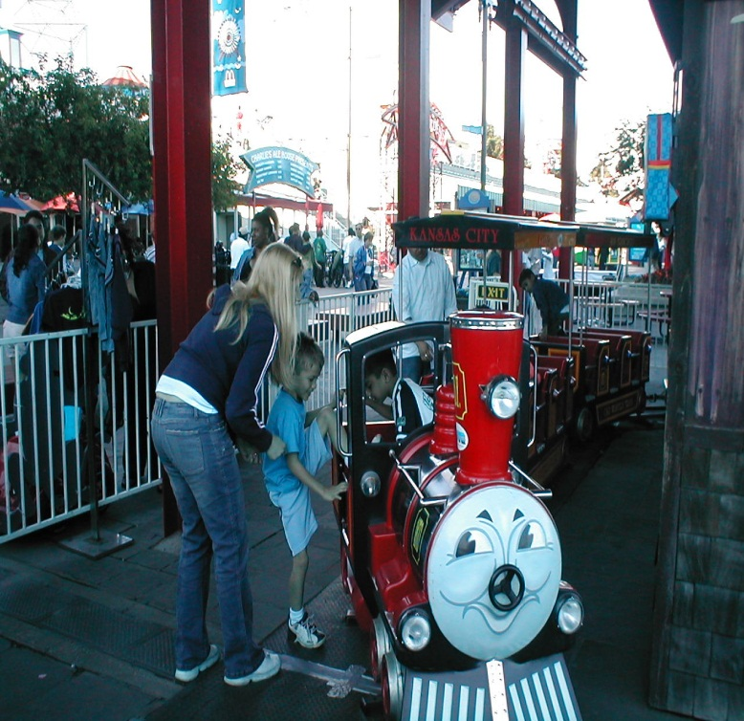
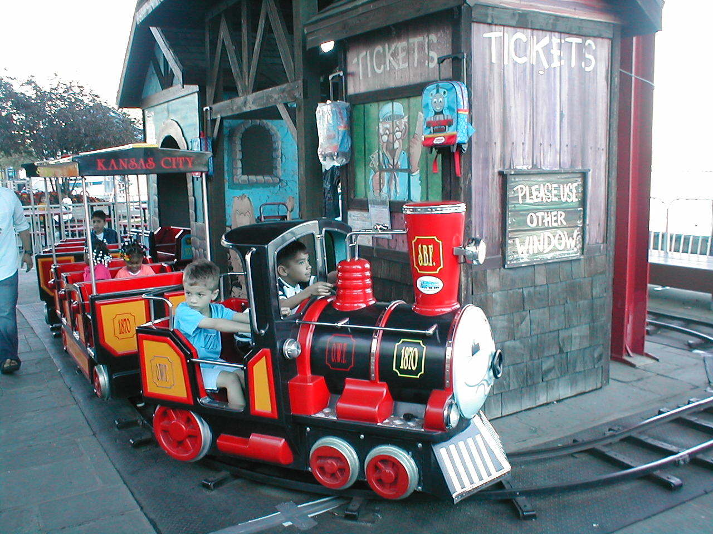
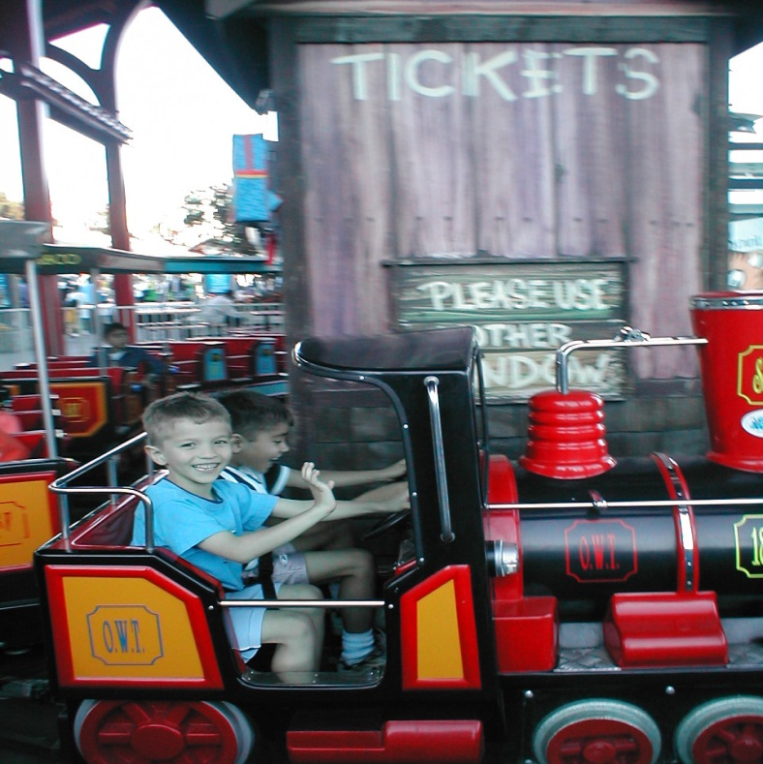
The learning ride!

Slide 14
Hi Dr Parra,
Thank you for taking the time to create all of the materials you make, I greatly appreciate it and I know many other students that take advantage of it also do.
I have found it to my advantage to really utilize what you have put together.
Thanks again!

Slide 15
The learning ride!

